Slide 1

How is Python Used in Data Analytics?
Dania, Leon, Dimitri, Sharleen

Slide 2

Core Uses in the Data Analytics Lifecycle
Data Gathering and ETL
- Python is used to build ETL pipelines that extract, transform, and load data from various databases and file formats like CSV, JSON, and Excel.

Slide 3

Data Cleaning and Wrangling
Python uses the Pandas library to clean messy datasets.
This includes handling missing values, removing duplicates, and reformatting data into "DataFrames" (structured tables) for easier manipulation.
For Example:
python can remove duplicate rows:
Sales_data = sales_data.drop_duplicates()

Slide 4

Analyzing Data
After the data is cleaned, Python can help answer different questions like, What was the total revenue, which product sold the most, which month had the highest sales, what is the average transaction amount and etc. These are just some of the many questions that python can help us answer.
For Example:
total_sales = sales_data["sales_amount"].sum()
Average_sales = sales_data["sale_amont"].mean()
Print(total_sales)
Print(average_sales)

Slide 5
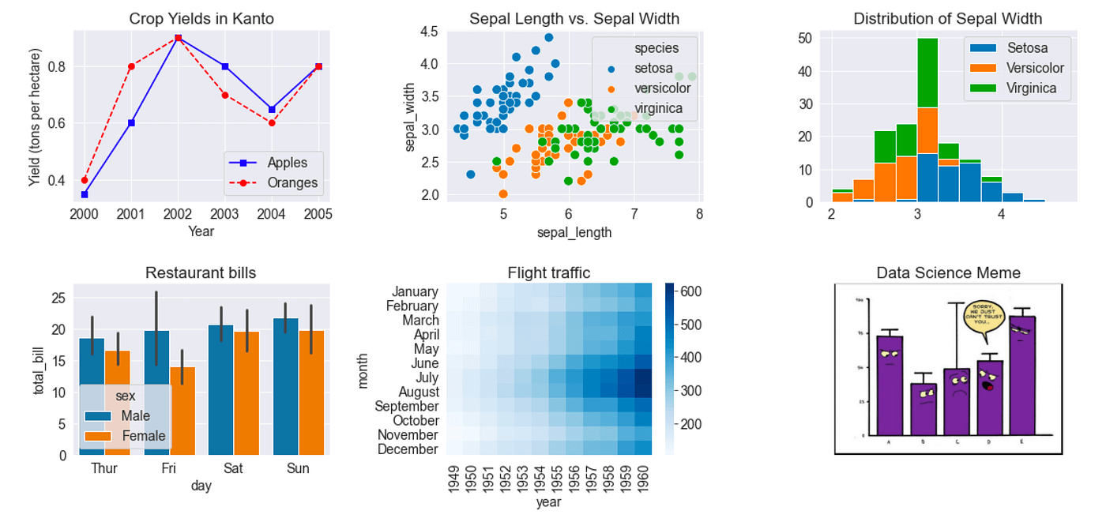
Data Visualization
To communicate findings, Python converts raw numbers into visual stories using Matplotlib for basic plots and Seaborn for more advanced statistical graphics like heatmaps and violin plots. Tools like Plotly allow for the creation of interactive, web-ready charts.
Example:
import matplotlib.pyplot as plt
months = ["Jan", "Feb", "Mar"]
sales = [1000, 1500, 1200]
plt.plot(months, sales)
plt.title("Monthly Sales")
plt.xlabel("Month")
plt.ylabel("Sales")
plt.show()

Slide 6
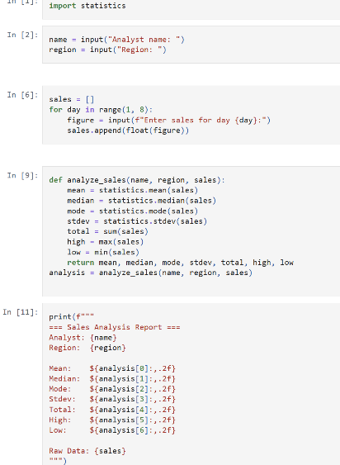
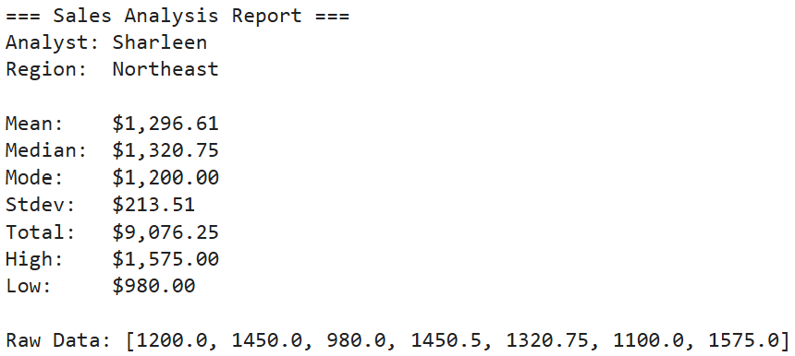
Weekly Sales Statistics Analyzer
This is a small example introduced in class (Ex.6.2) that uses Python to collect, analyze, and report on a week's worth of sales data.
Using the built-in statistics library, the program prompts the analyst to enter daily sales figures, then automatically calculates key metrics (mean, median, mode, standard deviation, total, high, and low) and outputs them in a clean, formatted report.
It demonstrates how just a few lines of Python can replace manual calculations and turn raw numbers into an analyst-ready summary.

